Slide 1
Opinion poll Application idea Implementation Walkthrough
CMP6213 Mobile and Wearable Application Development
Ahmed Mohamed – 18124225
Ahmed.mohamed3@mail.bcu.ac.uk

Slide 2
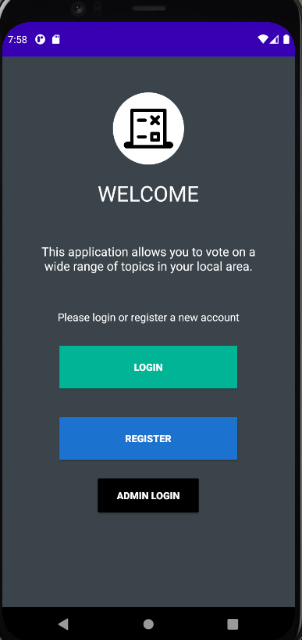
Overview
This is an opinion poll application. Its purpose is to allow users the ability to vote on specific topics that are important where they live. A user will be shown topics people in their postcode are interested in. when a user creates an account they will also be given the option to pick any topic as their main topic of interest.
The topics that are available at the moment are politics, celebrities, sports and movies.

Slide 3
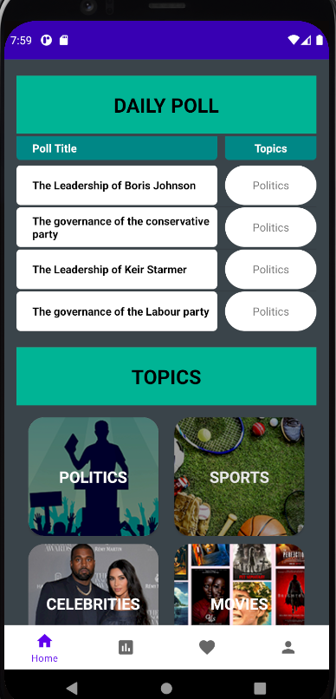
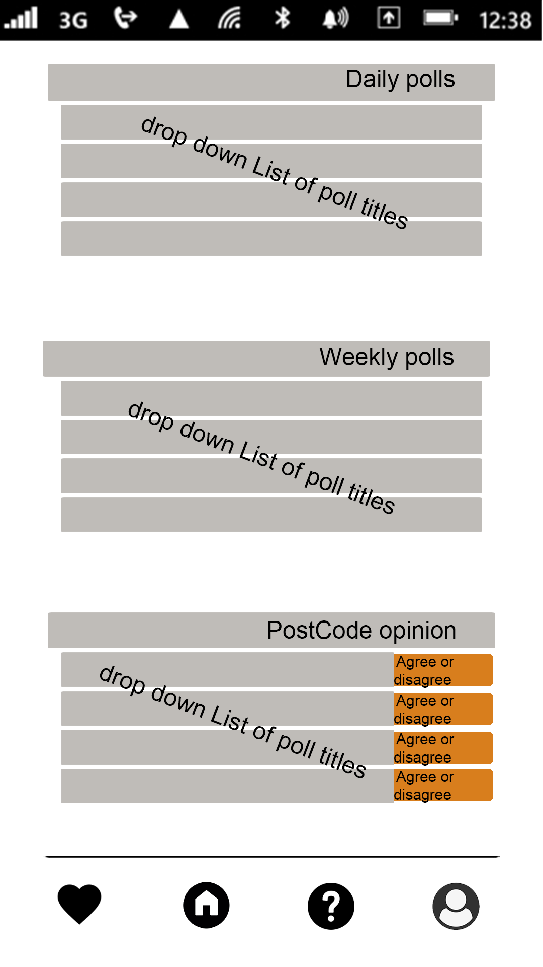
Design Decisions and changes (1)
There have been multiple design changes from the original design prototypes. one of the main ones is how each page of the app looks. The two screenshots show how the homepage was first designed to look and how it looks at the moment. As you can see 2 sections have been removed from the current design, this is because those sections have been moved to other pages.
After starting to build the application I realised that user might need a quick way to access different topics instead of having to look through pages multiple. Thus I have removed the “postcode opinion” section and the “weekly polls” section and replaced it with direct links to each topic.

Slide 4
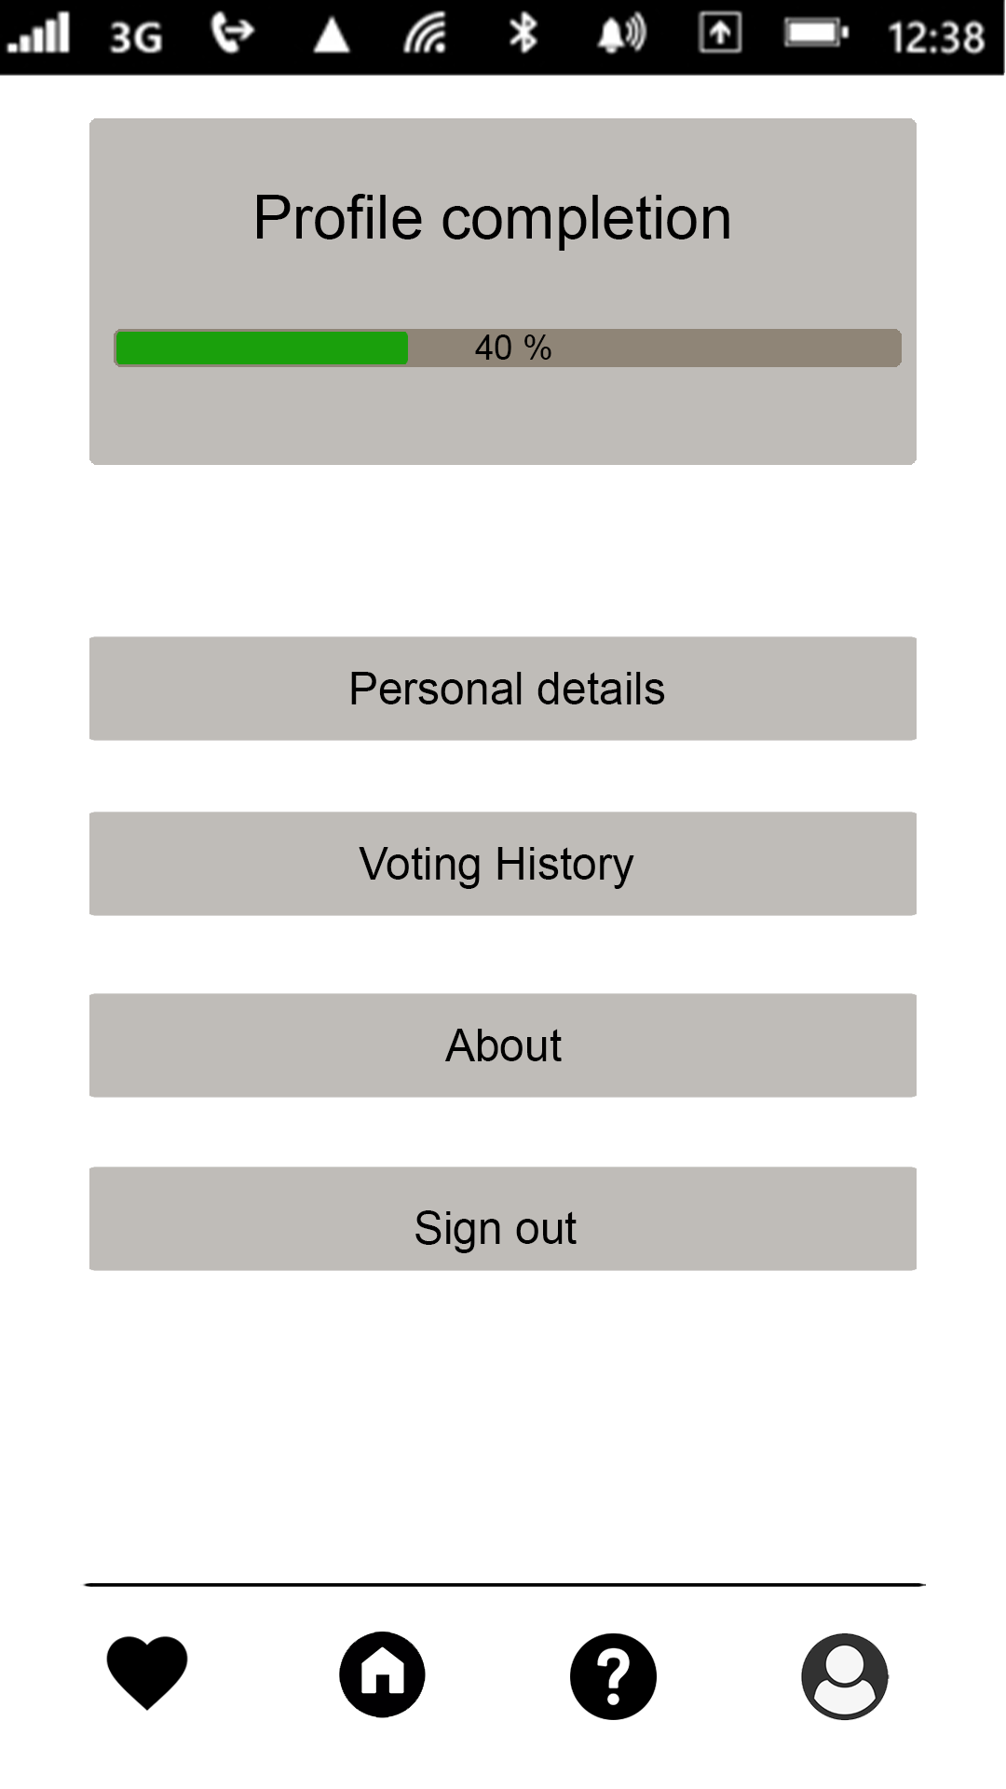
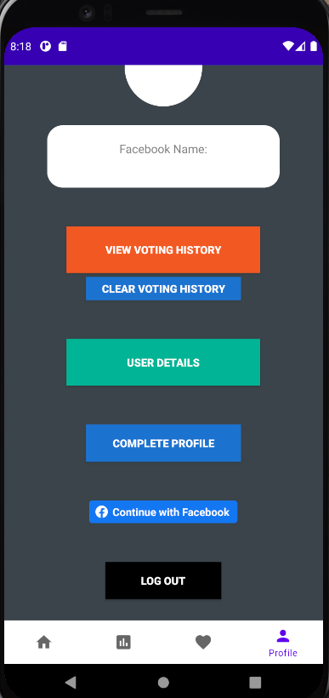
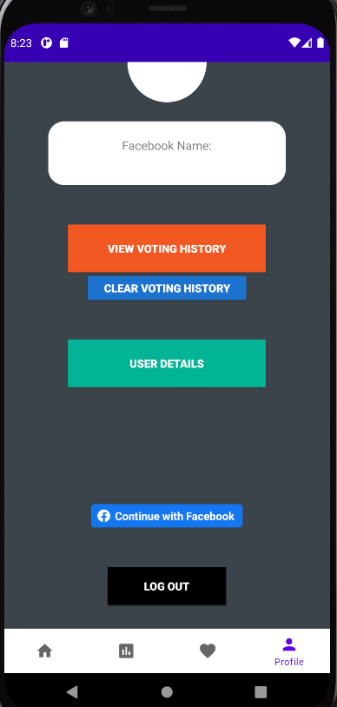
Design Decisions and changes (2)
The first two screenshots show how the profile section of the application was first designed for and how it currently look. The main thing to be removed is the profile completion progress bar, this was done because I realised there was no real need for a progress bar. it was a binary decision, either the user had completed their account setup or they had not.
If a user had not completed setting up their account a blue “complete profile” button would appear on their profile section. if they had completed setting up their account the button would be disabled and made invisible. As shown in the third screenshot

Slide 5
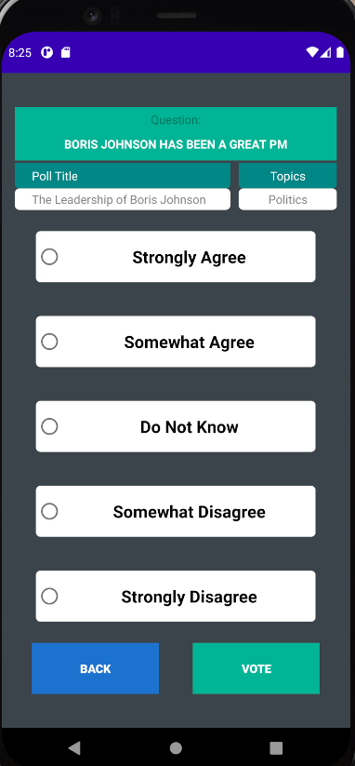
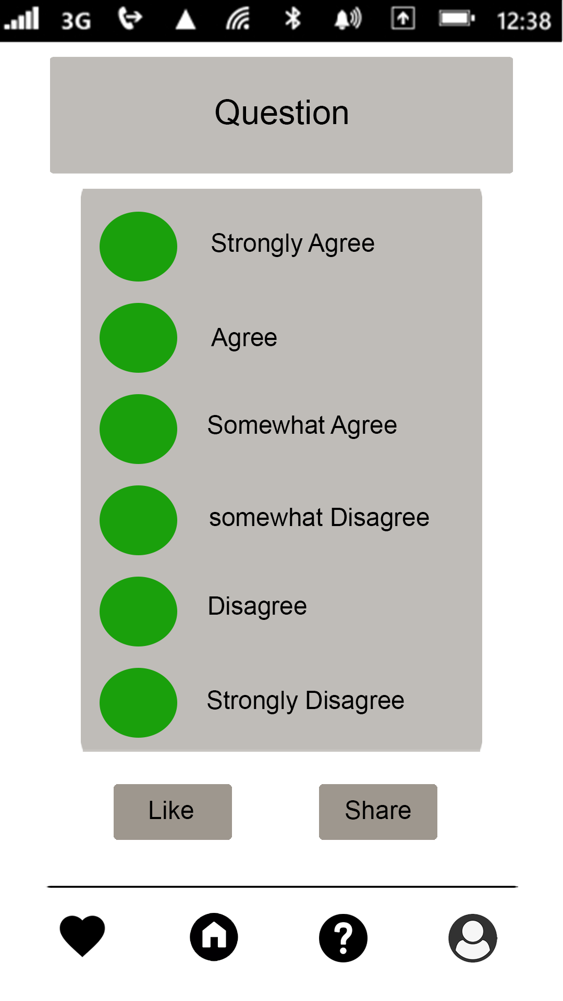
Design Decisions and changes (3)
There have been multiple other changes to the design. Another major one is how the voting page of the application looks. As seen on the left screenshot there were six possible voting options, on the current application there are only 5. This was done to make it easier to calculated an overall vote; this is discussed later in the presentation.
The share button has been removed, this is because the function to share has not been implemented in this application yet. However, the like button has been moved to the poll page.

Slide 6
Concepts/Technologies Covered (evidence on later slides)
I started by first creating design prototypes for the application that allowed me to find what technologies I would require to make the prototypes functional. One of the main areas focused on was how to implement persistent data in the application. I did this by using shared preferences, creating text files to store important data that is required to be readily available and Bundles to store small values.
One of the key requirements of this application was for it to be robust, to make sure this was the case I did various types of tests trying to finding possible ways a user might give unexpected inputs.
Multiple types of technologies were used in this application. The first is Picasso Which is a powerful image downloading and caching library for Android. This library is used to load a user's profile picture from their Facebook account. Glide is another image loader library that could be used; the only advantage Picasso has is it loads the image at a better quality.
Another technology that was used in this application is the Facebook SDK. it contains multiple types of API to communicate with Facebook servers. An important one for this application is the graph API. Which allowed me to make Direct request to Facebook servers and retrieved a user's name and profile picture.

Slide 7
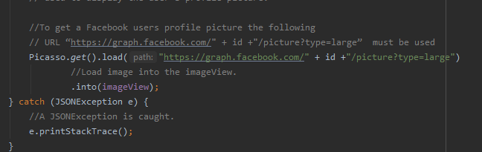
Picasso library
As shown in the screenshot the Picasso library is Implemented in the module gradle file and used in the graphRequest class when communicating with the Facebook graph API.
To get a Facebook user’s profile picture I used this URL
"https://graph.facebook.com/" + id +"/picture?type=large“
where “id” is Whoever profile picture my application is requesting.
The result is then placed into the imageview element.

Slide 8
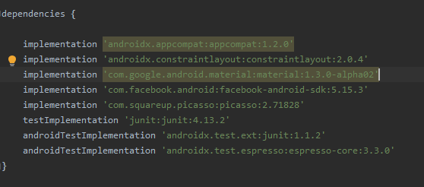
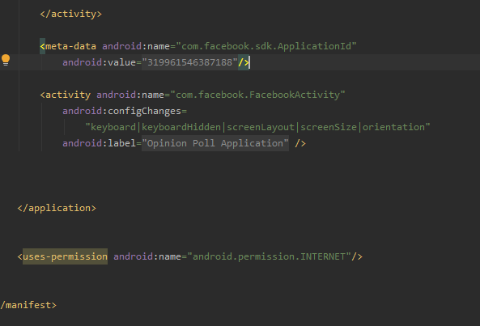
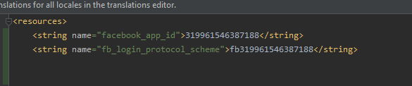
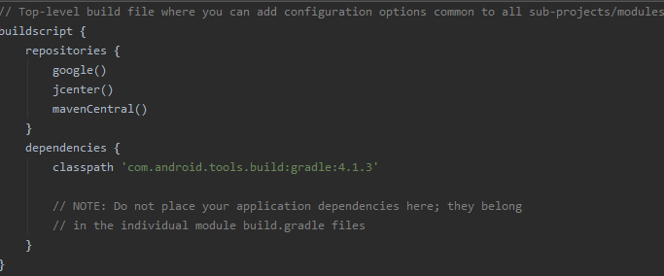
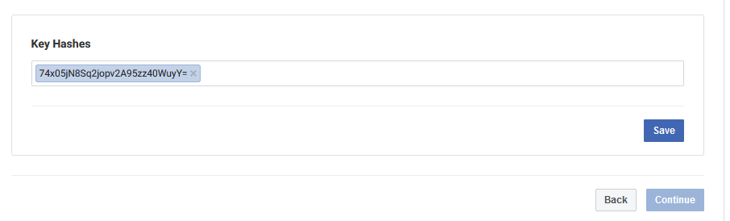
Facebook SDK
As shown in the screenshots I have added the Maven central repository to the top-level gradle file, which allows me to download the SDK from that repository. To compile the Facebook SDK I have also added the implementation line for the SDK into the module gradle file, so it can be compiled.
As also shown in the screenshot to ensure the authenticity of the interaction between my app and Facebook I supplied Facebook with an Android key hash for my development environment.
I also gave the Facebook SDK permission to connect to the internet by editing the Android manifest file.

Slide 9
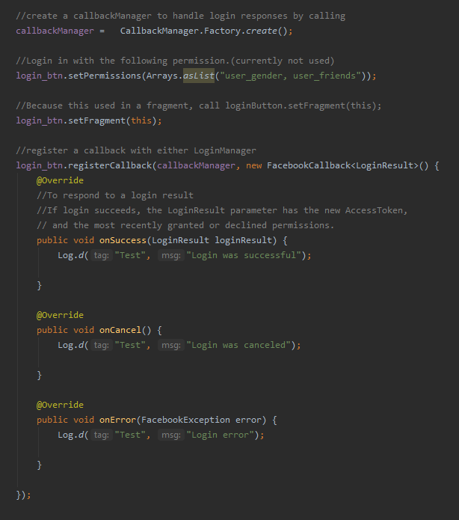
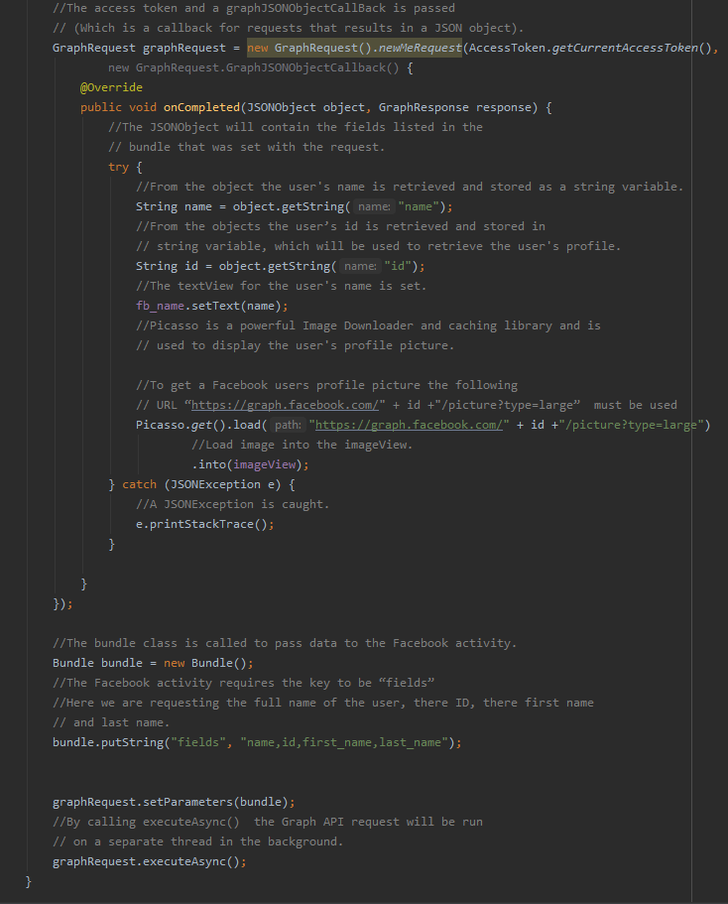
graph API
To request data from Facebook The graph API was used, All Facebook SDK interact with the graph API full stop as it's the main method of retrieving data from Facebook.
As shown in the first screenshot, to respond to a login result you need to register a callback with either the login manager or a login button. a callback is basically a background task that will notify you of its completion including errors and success.
The second screenshot shows the graphRequest class being used. This class allows communication with the graph API. As shown a bundle is used to store what fields are being requested from the API.

Slide 10
Application Wide Notes
The application is fully functional. I ran the application on a Pixel 4xl API 30, with a storage size of 18 GB.
Mostly Layout files are wrapped with a ScrollView, this should allow the UI of the application to run and display the same on an Android device with any resolution.
The application was designed and developed on Android Studios.
All resources required for the application have been included in the zip folder that I submitted.

Slide 11
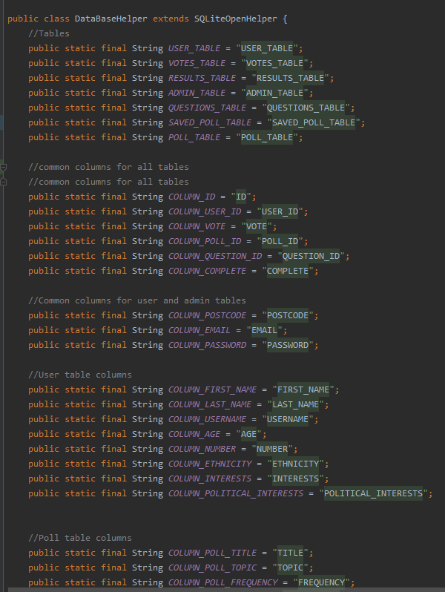
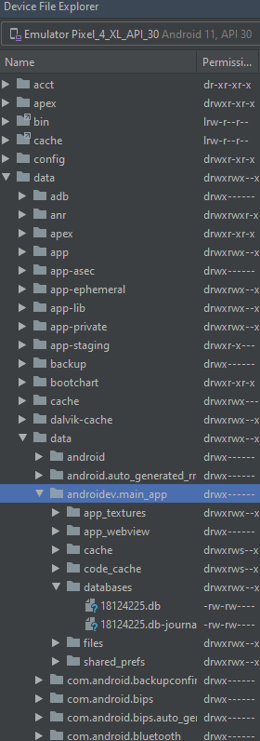
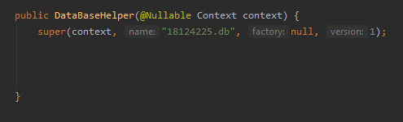
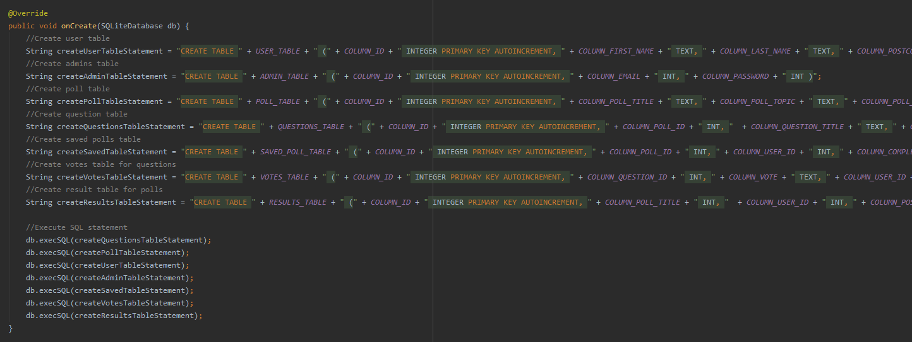
Local SQLite Database
To store data for this application I used the SQLite database built-in to Android Studios. The main reason I chose to do this was for faster application performance. This allowed me to test features much quicker than if I used Cloud storage for example firebase. Another reason I chose this was because throughout the development of this application there were periods of time where did not have a good internet connection, having the database locally allowed me to access it with no internet connection.
The Android.database.sqlite library is imported. The two classes from the library that are used for this application are SQLiteDatabase and SQLiteOpenHelper. The first class allows me to create a database with a specific name if it doesn't already exist, the second class allows me to perform CRUD operations on tables in the database.
SQLite is a opensource SQL database that stores data to a text file on a device. Android comes in with built in SQLite database implementation.
SQLite supports all the relational database features. In order to access this database, you don't need to establish any kind of connection
In order to create a database you just need to call this method openOrCreateDatabase with your database name and mode as a parameter. It returns an instance of SQLite database

Slide 12
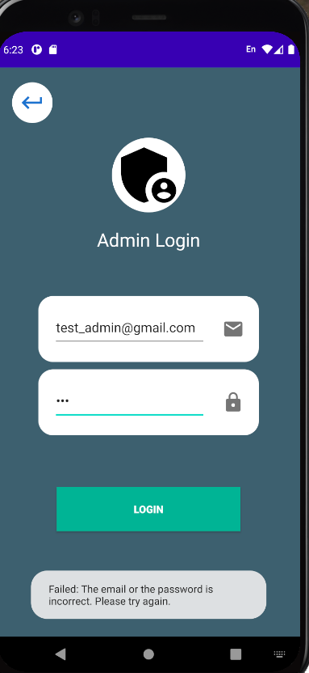
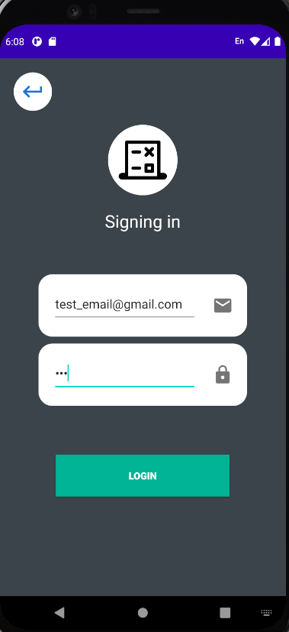
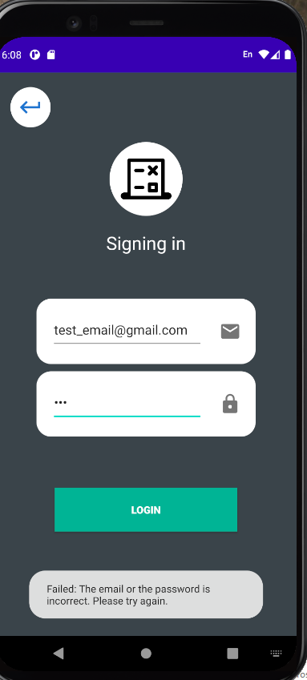
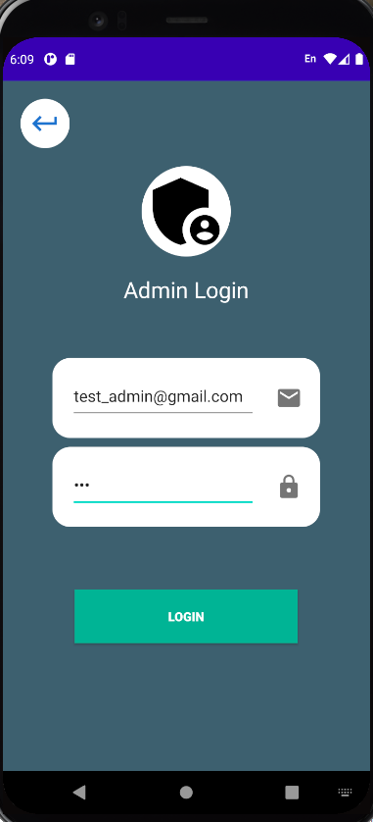
Login Screen for user & admin Operation Overview
As you can see on the left screenshots once a user inputs incorrect login credentials they are toasted a failed message and asked to try again. The same thing happens for an admin login attempt.
At the moment the email field is not locked to only emails so users can input anything. However, if what the user inputs is not in the database they will get the failed message.

Slide 13
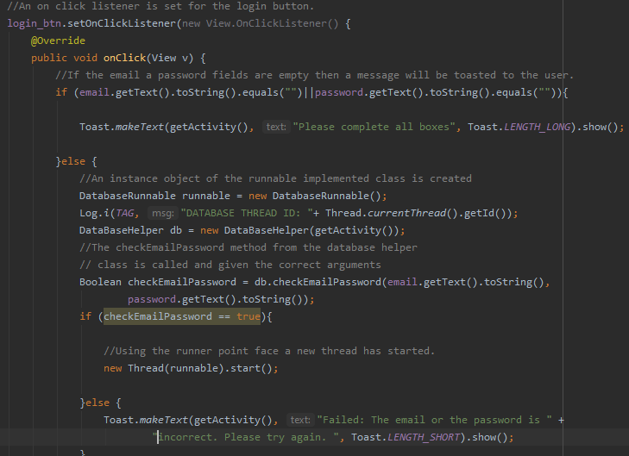
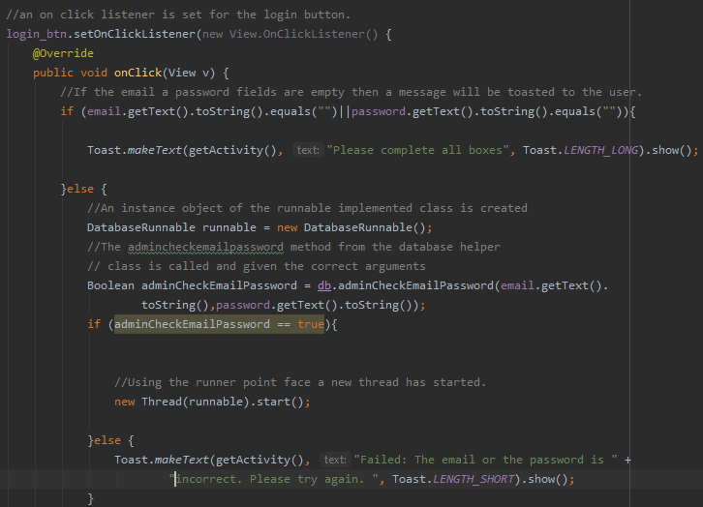
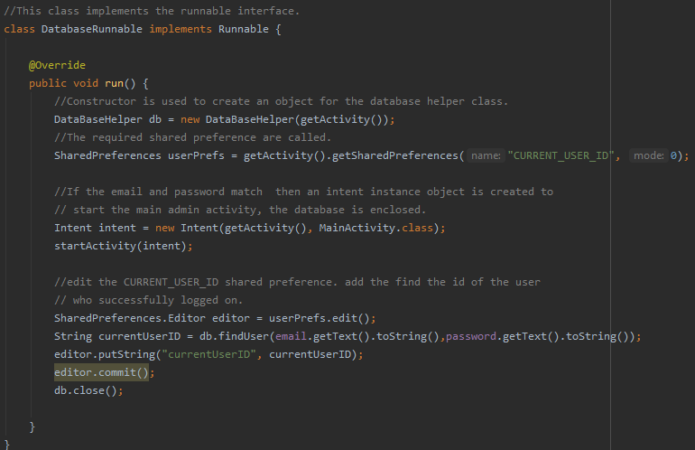
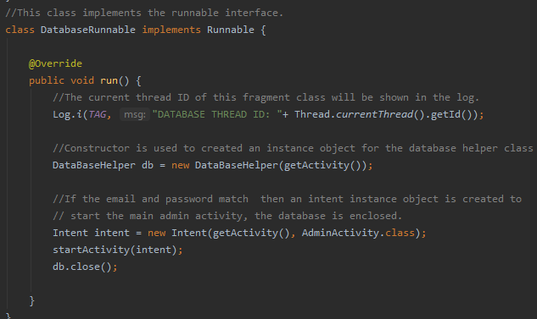
Login Screen for user & admin Operation code
User login
Admin login
First the user input fields are checked to see if they are empty, what the user has entered is checked against the database, If the correct details are not entered they will be toasted the error message. if they have the correct credentials an intent is used and they are taken to the home screen. The shared preference for the current user ID is updated. The same thing is done for the admin login however no shared preference is updated for them.

Slide 14
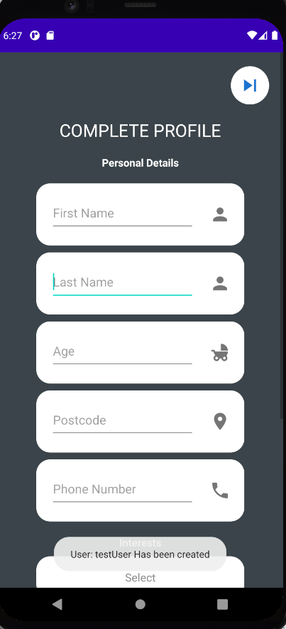
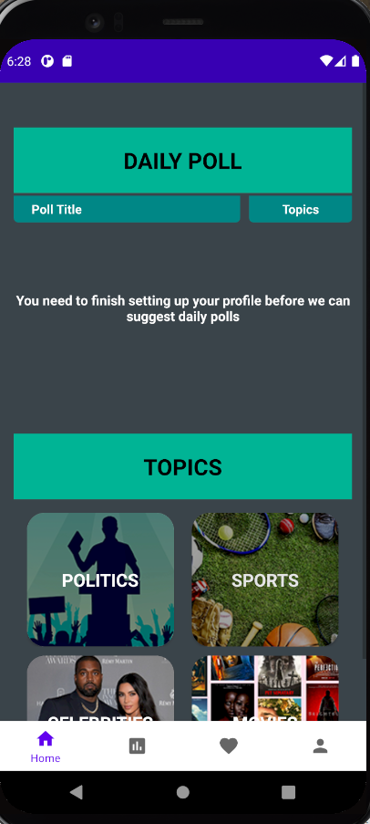
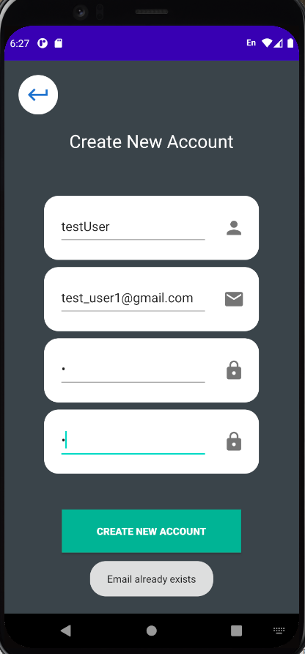
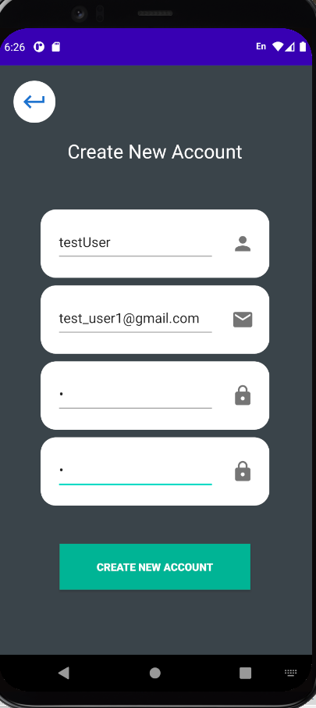
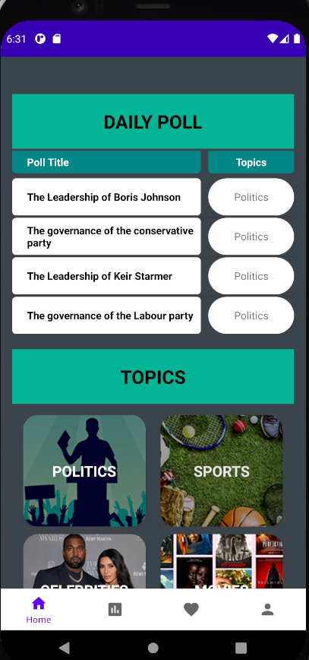
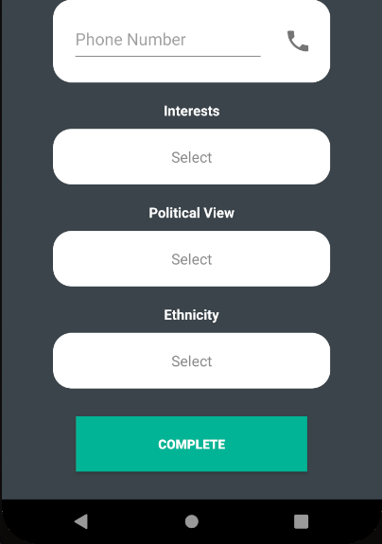
Registration Operation Overview
The user must use an email address that hasn't been used before to create an account. They are then asked to complete their profile by inputting more details about themselves. They are also given the option to skip this step; which takes them straight to the home screen. Because the user has not completed setting up their account no daily polls are shown for them as they have not given their main topic of interest.
If a user does complete their profile and gives the main topic of Interest the daily poll section is updated with polls with the same topic as the user’s main topic.
A user that skips completing their profile at the start of create an account, can complete the profile account later by going to their profile section of the application. The created account is set to not complete in the database

Slide 15
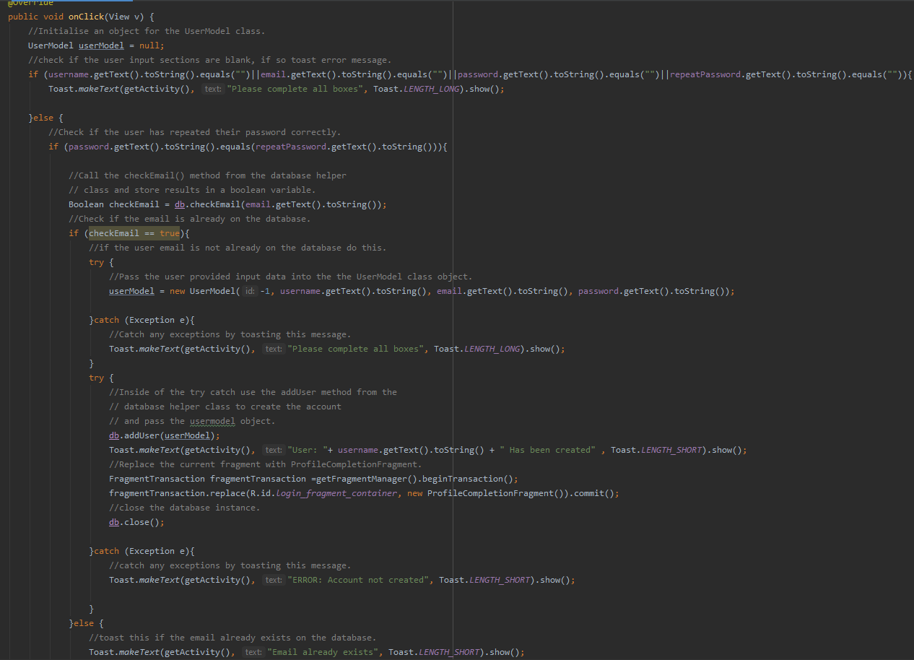
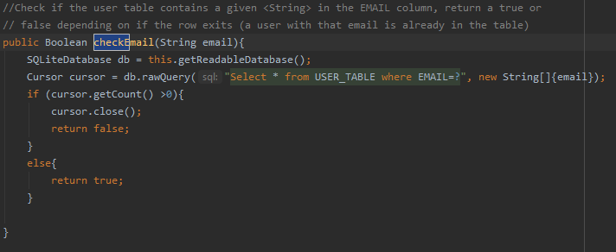
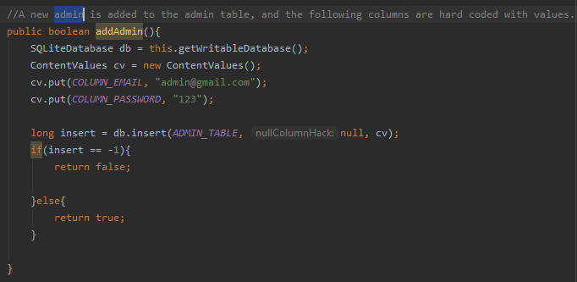
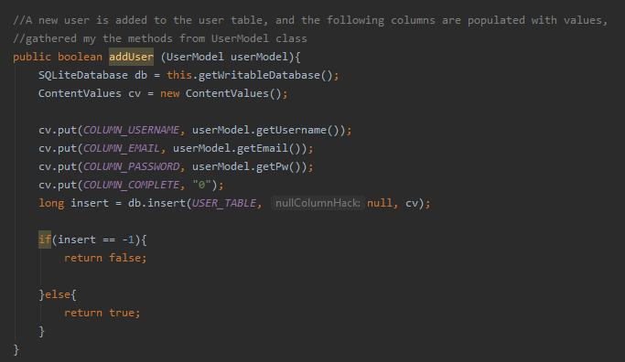
Registration Operation code
User Registration
First the user input Fields are checked to see if they are empty, then the password Fields are checked to see if the user has repeated their password correctly. The email the user inputs is then checked against the database to see if it already exists. If the email does not exist their account is created and then taken to the completing profile fragment.
Because the admin user has more privileges than a regular user they do not have a registration option. The admin credentials are hard-coded into the application. Once the admin button is pressed on the login screen one set of admin credentials are sent to the database.
Admin Registration

Slide 16
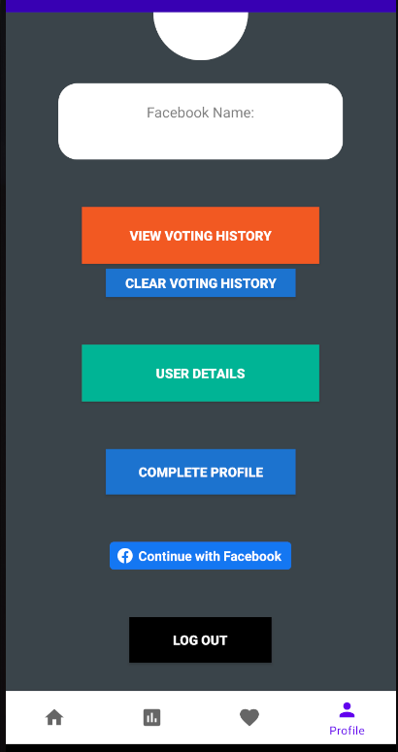
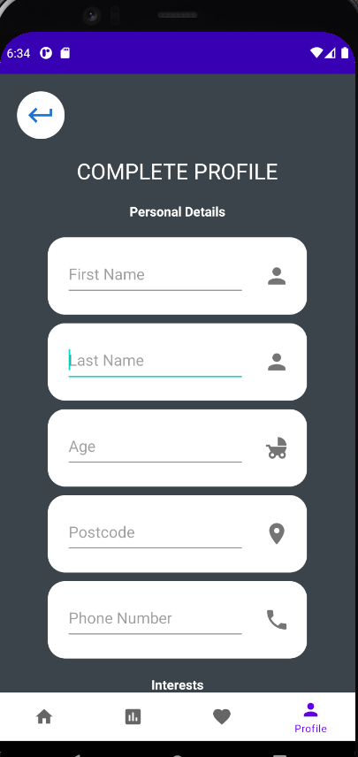
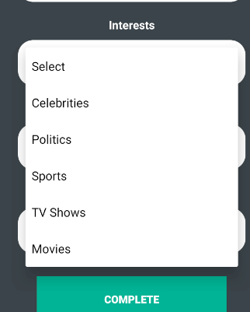
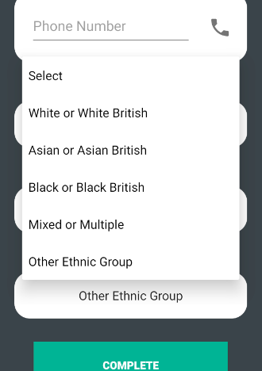
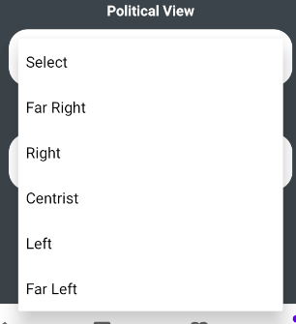
Completing account setup Operation Overview
If a user chooses to skip completing their profile when they first make an account they can do so later on by going to the profile section of the application. once the user completes their profile the “complete profile” button on the profile page is made invisible.

Slide 17
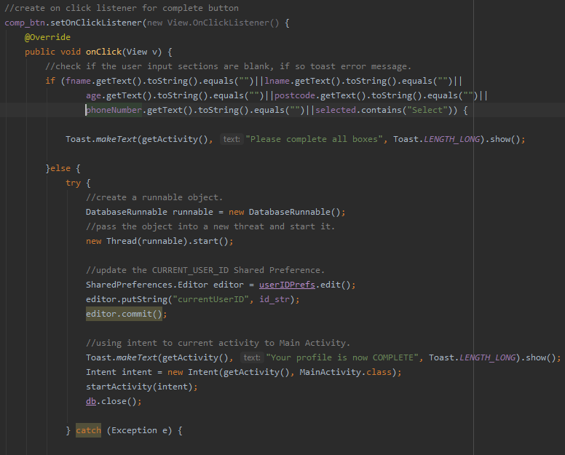
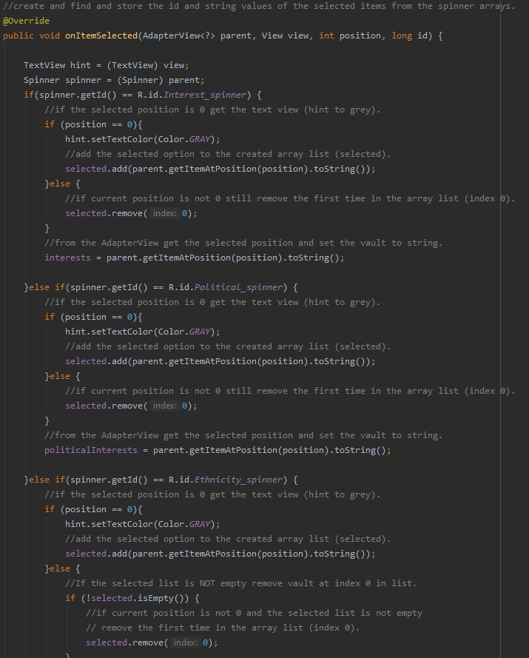
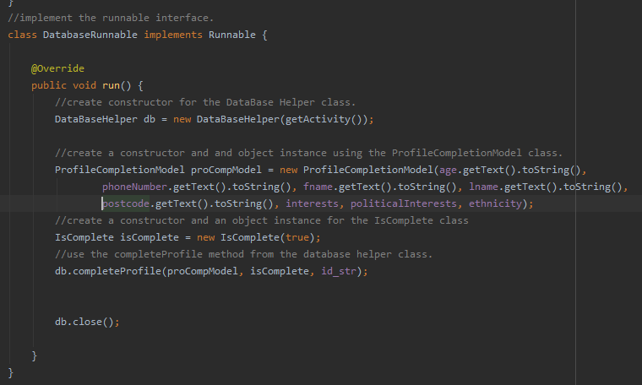
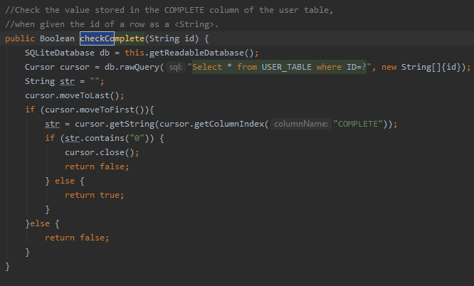
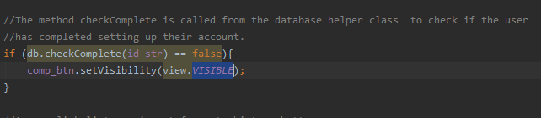
Completing account setup Operation code
The code to allow users to complete setting up their profile is the same for when they’re first asked and when they try to complete their profile later on through the profile section of the application. The only difference is if a user completes setting up their profile when they first make an account, on their profiles section of the app the “complete profile” button is automatically set to invisible.
This is done by checking the current user's ID on the database to see if their account is set to complete or not complete. the user table on the database has a column called complete, if there is a 0 value in that column the user has not completed setting up their profile. However, if there is a 1 value in that column the user has completed setting up their profile.
As can be seen in the database helper class if there is a 0 in that column a boolean value of false is Returned otherwise a boolean value of true is Returned.

Slide 18
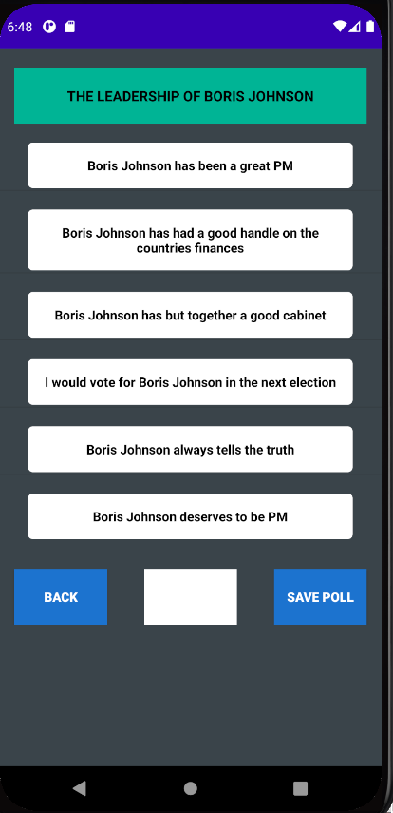
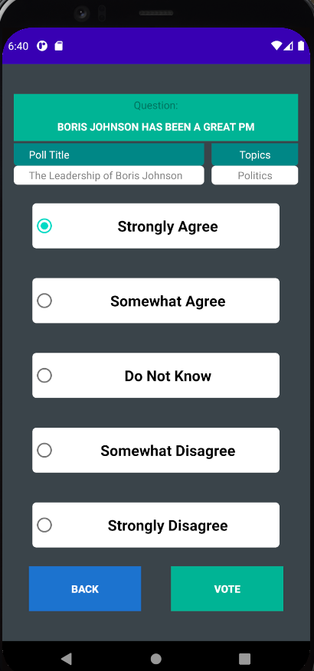


Voting on questions Operation Overview
Once a user has chosen a poll they will be shown a list of questions for that specific poll. Once a user clicks on a question they are taken to the voting screen.
Once a user has chosen a vote option and pressed the vote button one of two things will happen.
If the user has already voted on that specific question they will be toasted an error message and told that they have already voted, otherwise a green imageView tick will appear next to the question to show that their vote has been saved.

Slide 19



Voting on questions Operation code
First the application finds which vote option the user has pressed that option is then saved into a string value. if that string value contains the “strongly agree” option an int value of 1 is added to the results list, this is done for every possible option a user can choose. As can be seen in the screenshots each option is represented with a different int value which is then added to the results list.
To check if the user has already voted on the specific question the ID of that question and the user's ID is used to check against the database to see if that question has already been inserted into the votes table by using the check vote method in the database helper class. If so they toasted an error message and I returned to the poll activity via an intent,. otherwise the vote method from the database helper class is used and their vote option is saved to the votes table.
Vote options | Int value
Strongly Agree | 1
Somewhat Agree | 2
Do Not Know | 0
Somewhat Disagree | 3
Strongly Disagree | 4

Slide 20


Voting on polls Operation Overview
Once the user has finished answering each question and there is a green tick next to each question. The complete button is enabled. If the user presses the complete button an overall vote is generated for the poll and is saved into the database. A user is then toasted this message telling them to go into their profile section to view their voting history or they can go to the stats screen which is the button next to the home button.

Slide 21



Voting on polls Operation code
Only once a user has completed answering each question the complete button is enabled.
Once a user clicks the complete button an overall vote is generated for the whole poll instead of specific questions.
This is done by using the values stored inside of the results list. The values are added together and divided by 6 (which is the amount of questions).
This calculates the mean value of the user's votes. If the mean value comes out to three 3 for example the overall vote for that poll is “Somewhat disagree”.
If the size of the vote list is not 6 the complete button is not enabled. To mitigate errors if the size of the vote list exceeds 6 the voter list is cleared giving the user a chance to vote again.
First the checkVote method from the database helper class is used to check if the user has already voted on the poll. If they have an error message will be toasted otherwise using the completeVote method from the database helper class a poll vote is generated and saved into the database.
Vote options | Int value
Strongly Agree | 1
Somewhat Agree | 2
Do Not Know | 0
Somewhat Disagree | 3
Strongly Disagree | 4

Slide 22



Saving a poll Operation Overview
Once a user has answered all the questions but does not want to complete the poll they can press this save poll button. A user can also press this save poll button even if they don't answer any of the questions. If the poll is saved successfully a message will be toasted to the user and the user can find all their saved polls on the favourites screen by pressing this favourites button next to the stats button. If the user wants to they can clear their favourites which deletes the save polls from the database and thus the application to.

Slide 23


Saving a poll Operation code
First the vote list is checked to see if the size is equal to 6 if it's not equal to 6 the poll will be saved but not marked as complete. if a poll is saved but not marked as complete it will not show up on the completed section of the stats screen. However, if the voter list is equal to 6 meaning each question has been answered by the user their poll is saved and mark as complete which later on will appear in the completed section of the stats screen.
The savePoll method from the database helper class is used to save that specific poll into the saved polls table.

Slide 24




View poll results Operation Overview
Once a user has completed a poll and pressed the complete button and an overall vote for that specific poll has been generated, that poll is saved into the results table. When a user goes to their profile section and presses the voting history button a list of all the entries in the results table for the current user ID is shown. As can be seen on the right screenshots that specific fragment is inside of a scrollview allowing a user to view each topic separately.
A user can also view the result of polls about their main interest topic by going to the stats screen.

Slide 25






View poll results Operation code
First by using the findInterest method from the database helper class the current user’s main interest topic is retrieved from the database. Then the getResultsPollInterest method from the database helper class is used to retrieve results from the results table for only the current user and their main interest topic. That data is then inserted into a list object using the results model class. That list of objects is then used inside of a custom list adaptor.
I made a custom list adaptor to allow me to remove specific information from the objects in a recurring fashion.

Slide 26


View user details Operation Overview
Once a user has completed setting up their profile they can click the user details button on the profile screen. which takes them to a scrollview fragment that contains all of the users details from the database.

Slide 27


View user details Operation code
By using the getUserDetails method from the database helper class and giving the current user's ID a list of object is Returned. The profileCompletionModel class is used to create the objects.
Because there is only one object in the list I do not need to use a custom list adaptor. As shown in the screenshot by setting a variable at index 0 of the list I can use the get methods from the profileCompletionModel class to retrieve specific values I require and then setting the textviews accordingly.

Slide 28





Logging into Facebook Operation Overview
When a user presses the continue with Facebook button on the profile screen, a pop up for the Facebook SDK appears. Allowing the user to login with their credentials.
I made a temporary Facebook account to test this feature.
When the user logs on they'll be asked to accept the requested permission by the application.
Once they press continue the application will retrieve their profile picture and their Facebook name from Facebook and set it in the imageview and textview on the profile screen as shown in the screenshots.

Slide 29




Logging into Facebook Operation code
To respond to a login result, you need to register a callback with either LoginManager or LoginButton. If you register the callback with LoginButton, don't need to register the callback on Login manager. Then i add the LoginManager callback to the fragment's onCreate() method.
If login succeeds, the LoginResult parameter has the new AccessToken, and the most recently granted or declined permissions.
You don't need a registerCallback for login to succeed, you can choose to follow current access token changes with the AccessTokenTracker class
Finally, in the onActivityResult method, call callbackManager.onActivityResult to pass the login results to the LoginManager via callbackManager.
The app can only have one person at a time logged in, and LoginManager sets the current AccessToken and Profile for that user. The FacebookSDK saves this data in shared preferences and sets at the beginning of the session. You can see if a user is already logged in by checking AccessToken.getCurrentAccessToken() and Profile.getCurrentProfile().
Once a user logs out the imageview and textview are cleared.

Slide 30










Inserting questions and poll to database Operation Overview
Admin users have the ability to add polls and their questions into the database. I've included a Word document with my submission which contains poll questions and and poll titles. the check question data and check poll data buttons verify that the admin has followed the correct format. Format is very important as the application is looking for certain symbols to know when to start a new line and when to separate data. If the checks pass then the status textview is updated with the correct status.
If those status textviews show “SUCCESS -Ready” the administrator can press the upload button which sends the data to the database.
If however, the question and poll input fields are left empty and the admin presses upload the status text fields will be updated to show that no information was given.
If a question or a poll has already been added to the database the status textviews will also update to show this.
Status is updated
Admin login
Copy and past from the polls and questions document .
Status is updated
Copy and past from the polls and questions document .
Status is updated

Slide 31





Inserting questions and poll to database Operation code
What the admin user inserts into the poll field and question field are read roughly the same way, the only difference is that they use two different formats.
The first thing that happens is the openFileOuput method from the FileOutputStream class is used to create a file to store the poll data and question data. Then a bufferedReader is used to read each line of the text files.
The split method is used to separate the different data in that specific line of text. The symbol used to represent a split are 2 semicolons (::). In the case of polls the title of the poll, the poll topic and the frequency of that poll (normal/daily) are separated using that symbol. In the case of questions for polls the two semicolons are used to separate the question title from the poll title it's linked to.
A comma is replaced with a new line symbol (\n) to represent a new entry into the database.
Once each line of the text files is split using the separator symbol that line is added to a string list. Inside of the try catch, each index in the string list is assigned a string variable representing the title, topic and frequency of the poll. The same thing is done for the questions text file. Each index in the string list is assigned a string variable representing the Question title and poll title.
The ad questions and ad pause methods from the database helper class are used to insert the prepared data into the database. the assigned string variables from each string list are passed to each method.

Slide 32







Viewing all users / deleting them from the database Operation Overview
Once an admin user has logged on and gone to the view user screen. By pressing the show all users button they can see all the users from the database. if there are no users in the database then they will be given the message shown in the screenshot.
When an admin presses the “add a new user'' button they will be taken to the “create new account” screen which they can populate with the new users details. If the email is already in the database then the admin won't be able to add a new user with the same email.
Once a user has been successfully added to the database as shown in the screenshot a toast message will be shown.
The admin user can also remove users from the database. They can do this by pressing the delete icon next to each user's email.
Once the user has been successfully removed a success message will be toasted.
If the admin clicks on a user's username then that uses ID will be toasted to the screen.

Slide 33




Viewing all users / deleting them from the database Operation code
The getAllUsers method from the database helper class is used to retrieve all users from the database. That data is then put into a list of objects.
The UserModel class is used to create the objects. Using a custom listAdapter, recursively each user is removed from the list and placed into the listView.
An onClickListener is set for the delete imageview button. Once the icon is pressed, the deleteUser method from the database helper class is used to remove the user from the database (The user’s ID that is being deleted is passed to the method).
An onClickListener is set for the add user button which replaces the current fragment with the AddUserFragment previously discussed.

Slide 34
Conclusions – Key Features / Functionality Achieved
Normal user functionality
Facebook SDK used.
A mobile centred UI design was used
Facebook's graph API was used to retrieve a user's profile picture and name
MySQL database used for persistent storage
JSON objects used to store retrieved fields from Facebook
Admin functionality
An admin can add pulls to the database
An admin can add questions to the database
An admin can view all users on the application
An admin can create a new account for a user
An admin can delete a user from the database
A user can register an account and answer further questions about themselves.
A user can login with their email and password.
A user can view you multiple topics.
A user can vote on any topic.
A user has 5 possible voting options.
A user can view you they're voting history
A user can view their profile information
A user can save a poor
A user can login to Facebook to retrieve their profile picture and name.

Slide 35


Conclusions – Problems Encountered
A major problem that I encountered when setting up the Facebook API is I couldn't get the share button to work on the Poll activity class. I got the graph API working on the profile fragment class which allows the user to log into their account and for the app to retrieve the user's profile picture and name from Facebook. Once the user was successfully logged in the share button on the poll activity class should have been passed the access token from the login button. However, the callback manager on the Poll activity class could not communicate with the callback manager on the profile fragment class. That’s the reason there is no share feature on the application at the moment.
Another problem I encountered when setting up the Facebook API was the onActivityResult method for facebook in the profile fragment class clashes with the onActivityResult method for Android fragments. Facebook recommends that the method should have the access privilege of private; however, the method with the same name for Android fragments is also set as private thus they clash and give a syntax error. I had to assign weaker access privileges for Facebook's onActivityResult method. I'm not sure what complications this could cause in the future.
Enabling virtualisation technology in my computer's BIOS. When creating an Android virtual device in the AVD manager I specified that the emulator should use hardware to emulate the GPU of the virtual device. Hardware acceleration is recommended because it's usually faster. Trying to find the correct option on my motherboard's BIOS screen was very difficult as each manufacturer has their own BIOS screen with different named settings. I'm using an Asus rog strix b550-F motherboard and the virtualisation technology setting is called VT-x on the BIOS screen. Without enabling this the virtual device cannot start up.
https://stackoverflow.com/questions/42471855/android-studio-enable-vt-x-in-your-bios-setting/47261223
https://developer.android.com/studio/run/emulator-acceleration
Another major problem I encountered was to do with the database and listViews. As an example, if I sent a query to the database to retrieve the current users details from the user table but I only wanted certain columns for one listView and other columns for a different listView. Using the default listView I couldn't find Specify which columns from the database I wanted for that specific listView, as they were objects in an array list. That is when I learnt how to create custom list adapter classes. This way I had a lot more control over Which columns I wanted to display on a specific listViews.
https://stackoverflow.com/questions/37460133/how-to-refresh-listview-in-a-custom-adapter/
https://stackoverflow.com/questions/16076985/listview-row-buttons-how-do-i-create-a-custom-adapter-that-connects-a-view-oncl

Slide 36
Conclusions – Improvements / Future Work
Allow users to upload profile pictures when setting off their account.
Have a section on the stats screen to show vote results from the user's postcode
Give users the ability to share screenshots of polls to their Facebook feed.
https://developers.facebook.com/docs/sharing/android#Additional
Add a Twitter API so users can login and share are on Twitter.
https://developer.twitter.com/en/docs/twitter-api/getting-started/about-twitter-api
Allow users the ability to update profile details.
Allow the application to lock people into their postcode so users can only vote on topics that are popular in their area.
Set up Google firebase database to have a secure way to store persistent data for users.
https://firebase.google.com/docs/android/setup
Import application to Google firebase.

